Slide 1

Final Project Machine Learning with H2O.ai
Mohan, Anushadevi
CSCI E-63 Big Data Analytics
2016
Harvard University Extension School
Prof. Zoran B. Djordjević

Slide 2
Introduction
H2O is fast, scalable, open-source machine learning application that includes APIs for Python, R, Java, Scala etc. and a built-in web GUI
H2O can process very large datasets in memory using in-memory compression techniques
Offers most common machine learning algorithms
Supervised Learning
Generalized Linear modeling (Linear Regression, Logistic Regression)
Ensembles (Random Forest, Gradient Boosting Machine)
Deep Neural Networks (Deep Learning)
Unsupervised Learning
K-means clustering, PCA, Generalized low rank models
Has built-in integration tools for platforms like HDFS, Amazon S3, SQL and NoSQL

Slide 3
Problem Statements
Evaluate the following different ways of using H2O.ai for Machine learning
H2O directly from Python
H2O directly from R
PySparkling from local standalone Spark cluster
H2O Flow on Desktop mode
Demonstrate the use of following H2O algorithms on a lesser known Benchmark dataset used by academics and compare the performance metrics
Deep Learning
Gradient Boosting Machine
Generalized Linear Model
Distributed Random Forest
Ensembles stacking using R

Slide 4
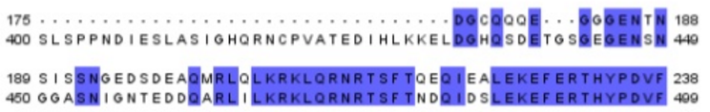
FoldPro Dataset
Binary classification problem of predicting whether or not the unknown fold of a target protein (query) is similar to an already known template protein structure
Template
Query
Template
Query
Pairwise similarity between template and query protein
Level 1: Family
Template and query proteins belong to the same family
Decrease in sequence identity between template and query protein
Level 2: Superfamily
Template and query proteins belong to the superfamily level
Level 3: Fold
Template and query proteins belong to the hardest fold level

Slide 5
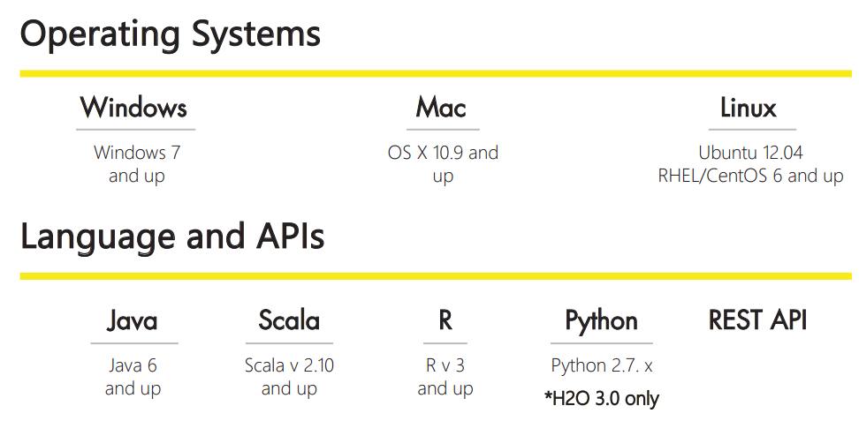
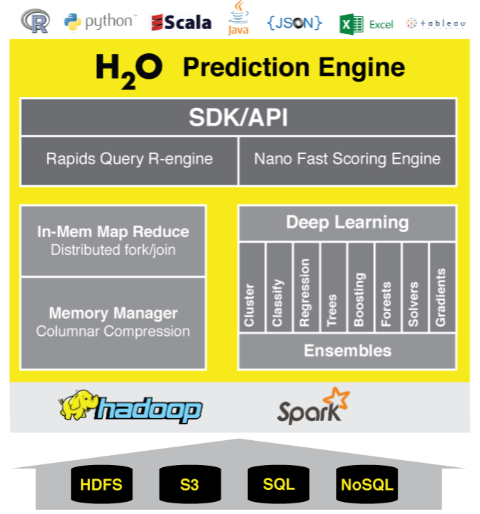
H2O Architecture

Slide 6
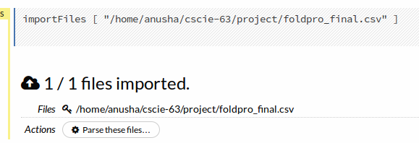
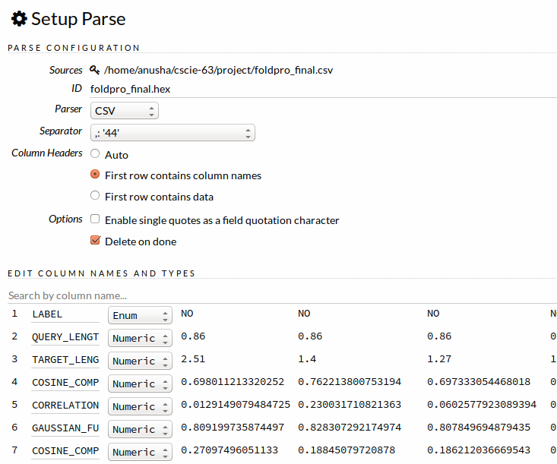
H2O Flow

Slide 7
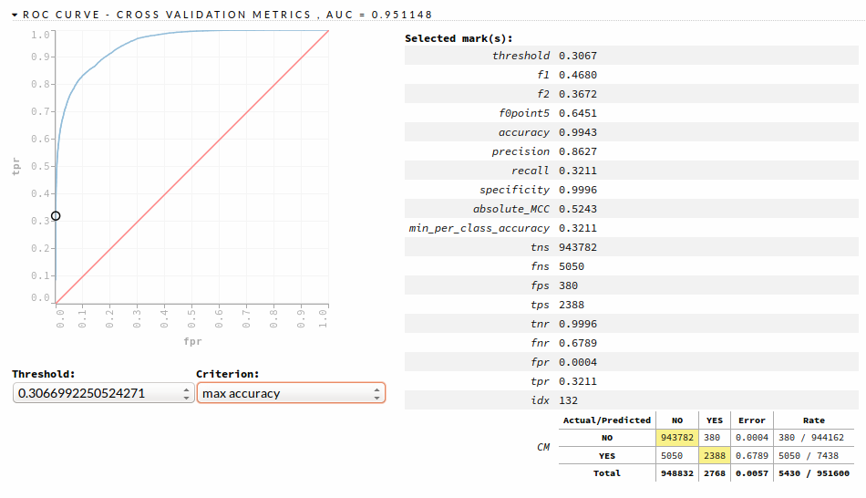
Model Performance Evaluation

Slide 8
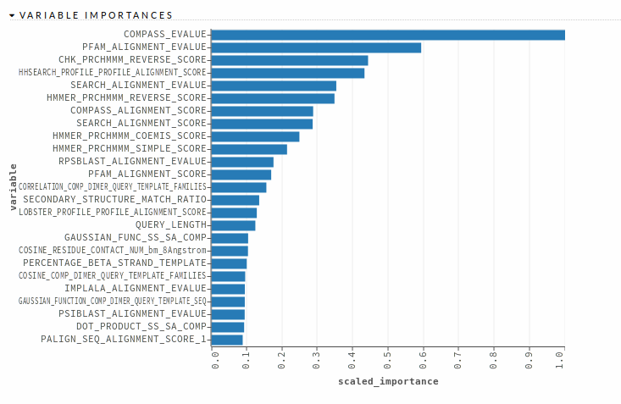
H2O Flow – Feature Importances

Slide 9
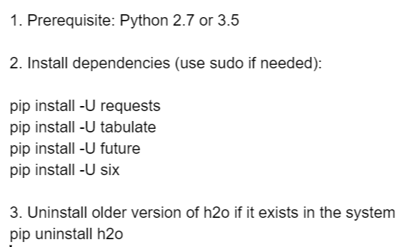
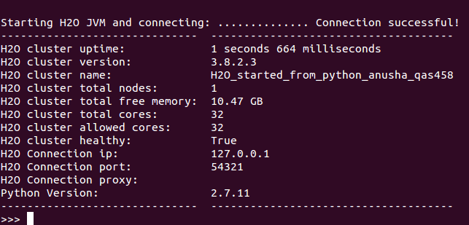
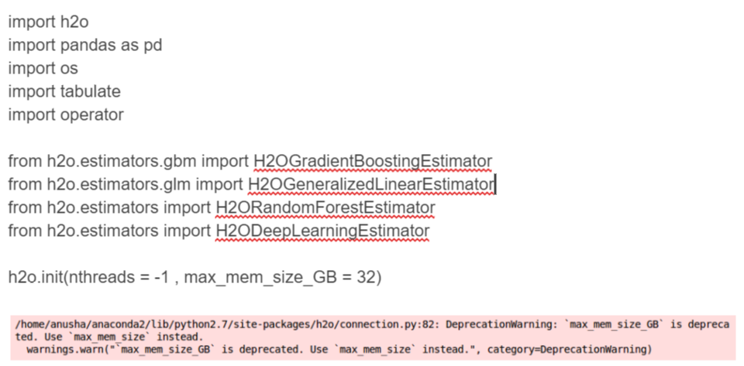
H2O on python

Slide 10
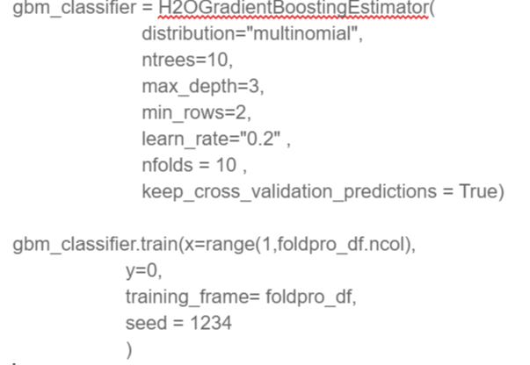
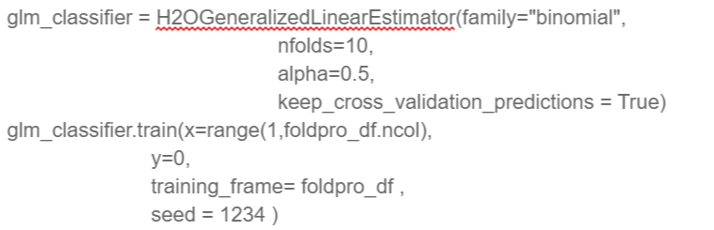
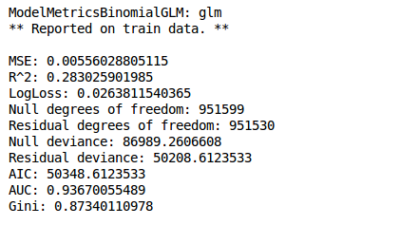
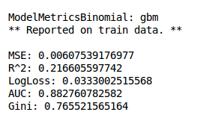
H2O on python (gradient boosting and logistic regression classifier)

Slide 11
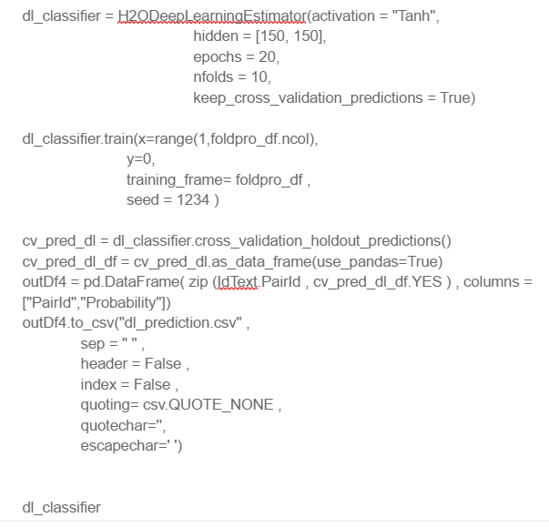
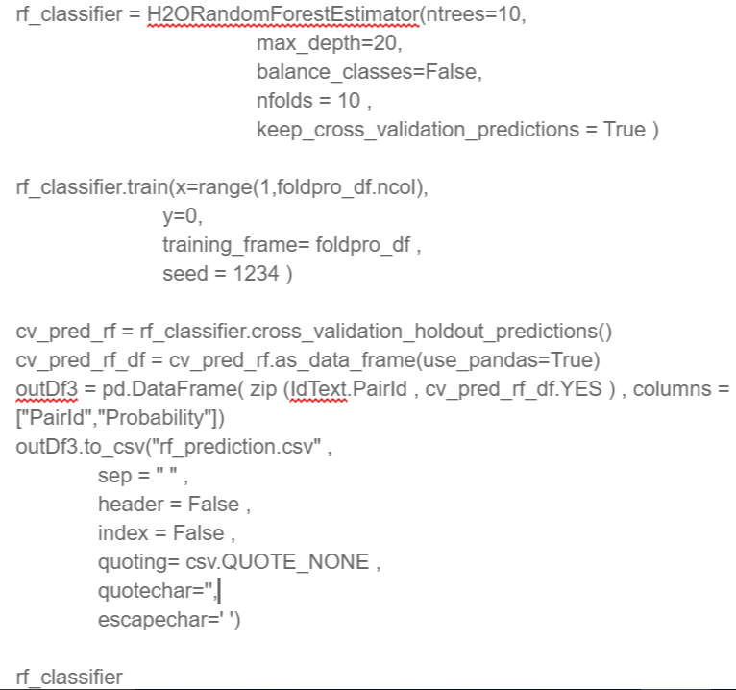
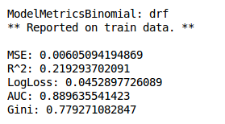
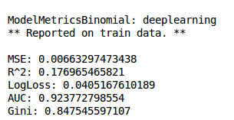
H2O on python (Random Forest and Deep Learning classifier)

Slide 12
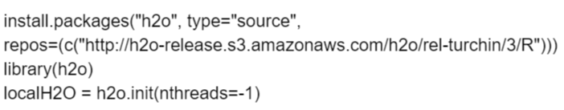
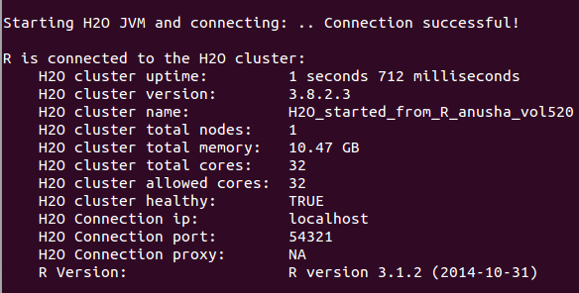

H2O on R (Ensemble)

Slide 13


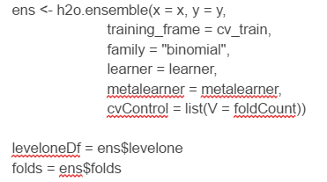
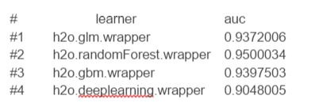
H2O Ensemble
Results

Slide 14
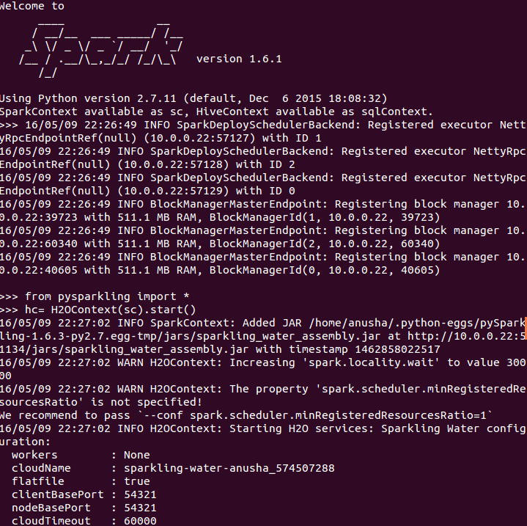
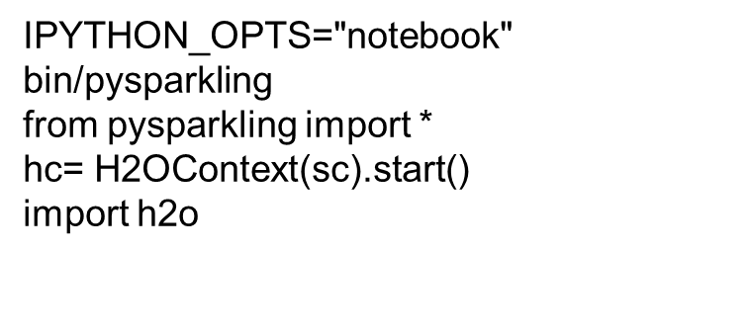
Pysparkling H2O

Slide 15
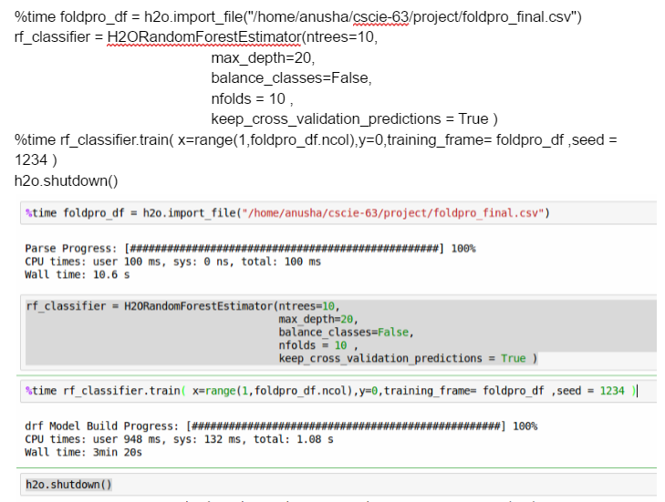
Pysparkling H2O

Slide 16
Results

Slide 17
Pros and Cons
Pros
H2O Flow is a very efficient tool and can allow for fast iteration cycle.
The software did not crash for the most part except for errors from the input side. The software seems to reliable & mature
With so many different APIs it is very easy to integrate H2O with things I already know
Cons:
H2O has too much documentation available on the web and it seems some of them is based on old versions of H20 and it can get too confusing.
H2O did could use more functions which can help building cross-validation of ensemble modeling easy
The SVM light parser which came with software was not able to parse the file correctly. So, there is definitely room for improvement in the supported features list.

Slide 18
Sources
http://learn.h2o.ai/content/WhatIsH2O.html
http://www.slideshare.net/avrilcoghlan/pairwise-sequence-alignment
http://www.h2o.ai/product
http://www.h2o.ai/product/recommended-systems-for-h2o/
http://www.ncbi.nlm.nih.gov/pubmed/25350499
http://h2oworld.h2o.ai/resources.html

Slide 19
YouTube URLs, Last Page
Two minute (short): https://www.youtube.com/watch?v=v2yGoV2HDTc
15 minutes (long): https://www.youtube.com/watch?v=-q4orm8zFDQ

